Slide 1
Implementation of Monte Carlo Search Tree
Cong, Liu (A20343692)
Man, Liu (A20355651)

Slide 2
Contents
1. Monte Carlo Algorithm
1.1 MCST
1.2 UCT
2. Project Guide
2.1 Details in implementation
2.2 Guide of Tic Tac Toe
3. Improvements in the Future

Slide 3
Monte Carlo Algorithm
Randomized Algorithms
Las Vegas
Always get the correct answer
Monte Carlo
Correct answer with a property

Slide 4
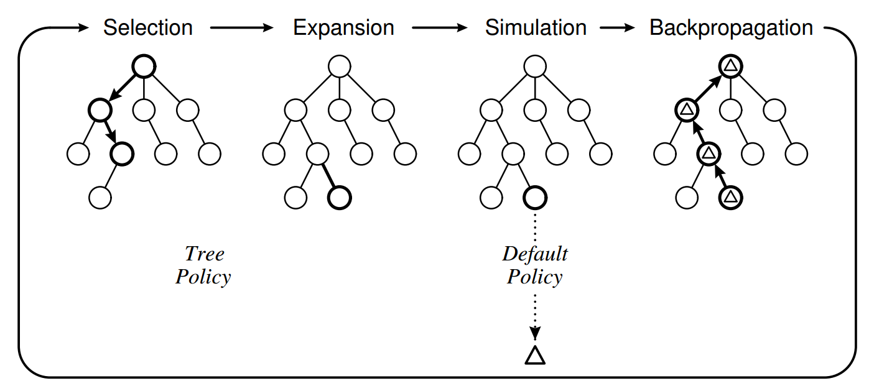
Monte Carlo Search Tree

Slide 5
Selection
Starting from the root node, when within computational budget, select a child node depends on a tree policy until reach an unexpanded child.
Expansion
One (or more) child nodes are added to the expanded tree.
Simulation
A simulation rule runs on the expanded node, then outcome a reward value according to default policy.
Backpropagation
The reward of the nodes along the chosen path return back to root node to update its statistics.

Slide 6
Tree policy: Select or create a leaf node in the search tree (selection and expansion)
Default policy: Applied on a node (or nodes) that isn’t existed in this search tree yet to give an estimate value.

Slide 7
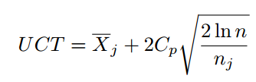
Upper Bound Certification Tree(UCT)
Used to solve multi-armed bandit problems.
The object of Upper Confidence Bounds(UCB) is to find the optimal arm.
A partial search tree is built iteratively using UCT.

Slide 8
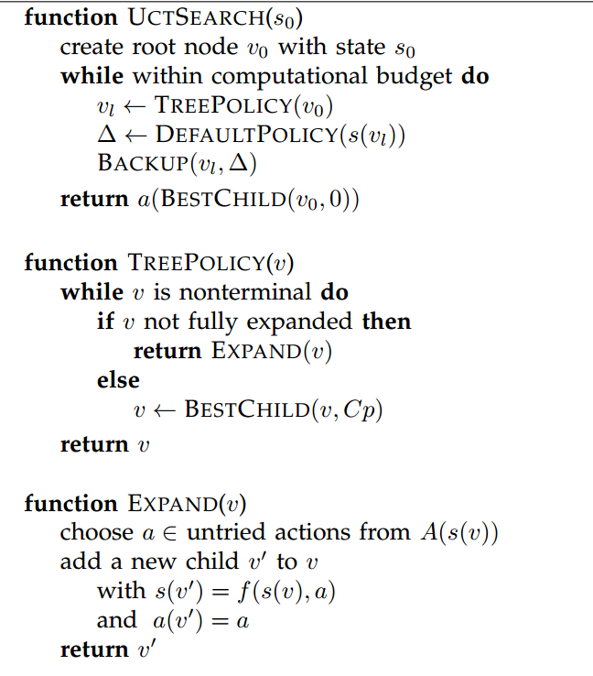
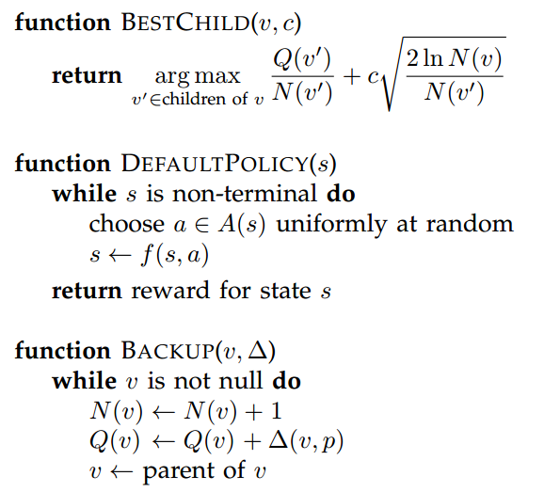
Pseudocode of UCT Search

Slide 9
Details in implementation
In each node v, contains four properties associated with it. Its state s(v), the incoming action a(v), the total simulation reward Q(v) and its visit count N(v). The term Δ (v, p) represents the reward of player p at node v. So that Q(v)/N(v) is an approximation of the node’s game-theoretic value

Slide 10
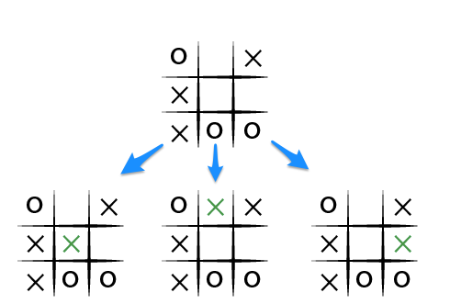
Intro to Tic Tac Toe game
A simple game for 2 players
Game position: 10⁴
Computer Strength: Perfect

Slide 11
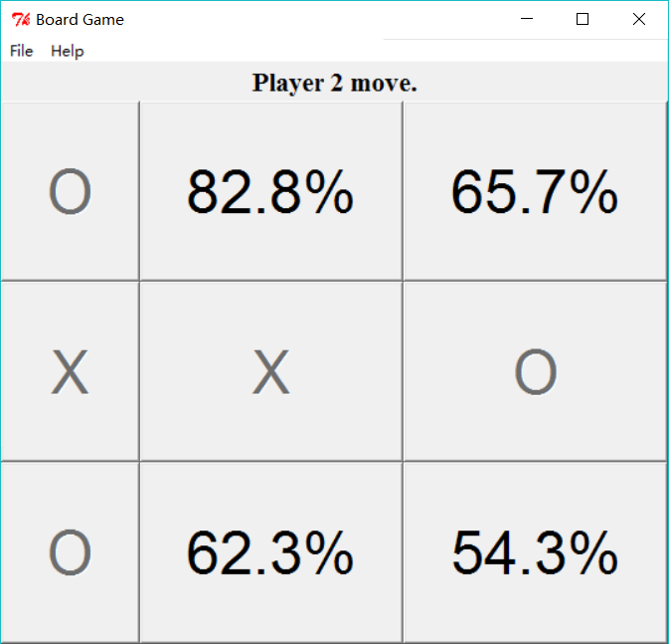
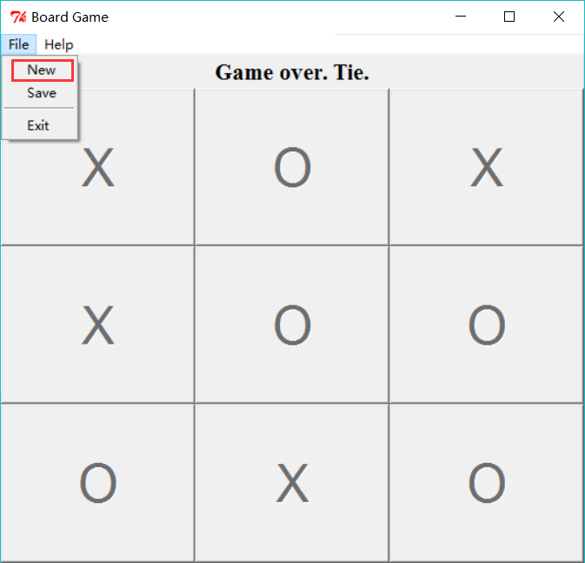
Intro to our program
MCST AI moves first
All the children possibilities(rewards) of the previous action node is shown directly on the game board

Slide 12
Improvements in the future
I/O
Parameters
Bigger game board
Time performance evaluation
AI joins to play at the middle of the game

